Slide 1
JS Frameworks Comparison for WebApp SDK

Slide 2
Outline
Goal
In this session we compare the pros and cons of modern web frameworks from different technical aspects.
Candidates
Backbone+jQuery, Angular, React, Vue
Trends
Hot topics of modern web development
Virtual DOM
Data-binding
Code reuse
Client / Sever separation (SPA)
State management
Notes:
We compare the four candidates by different technical perspective. The angular react and vue are the most popular frameworks nowadays, but we also include the backbone-jquery as an options because the legacy meeting thin client was made by backbone-jquery.

Slide 3
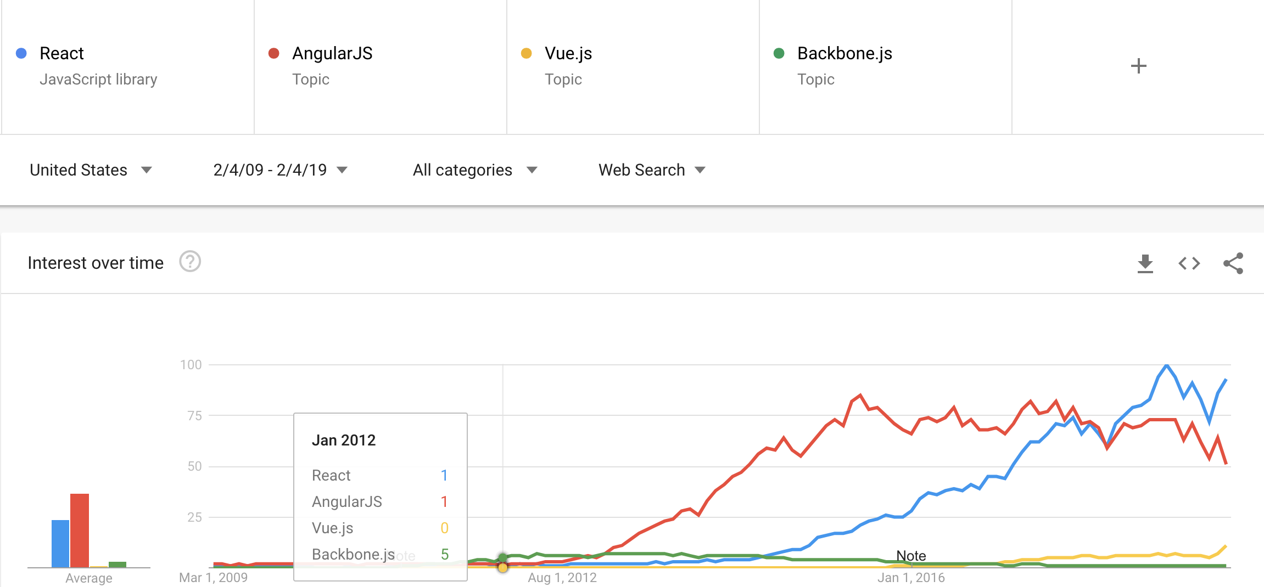
Trends
MVC + SPA
Data-binding
UI Components
Virtual DOM
Notes:
Let begin with the trend. As you can see in the line chart of search frequency,

Slide 4
DOM
Document Object Model
Language-independent application programming interface
Maintain everything about the page
Data, states, style and document structure… etc

Slide 5
DOM Manipulation Issues
Regular DOM manipulation is slow
Duplicated internal function calls in real scenario
Multiple actions happened in a short time
E.g. “change the text of an element” and “hide an element”
Partial area rendering
parse x as HTML
ask browser extensions for permission
destroy existing child nodes of element
create child nodes
recompute styles which are defined in terms of parent-child relationships
recompute physical dimensions of page elements
notify browser extensions of the change
update JavaScript variables which are handles to real DOM nodes
element.innerHTML = x

Slide 6
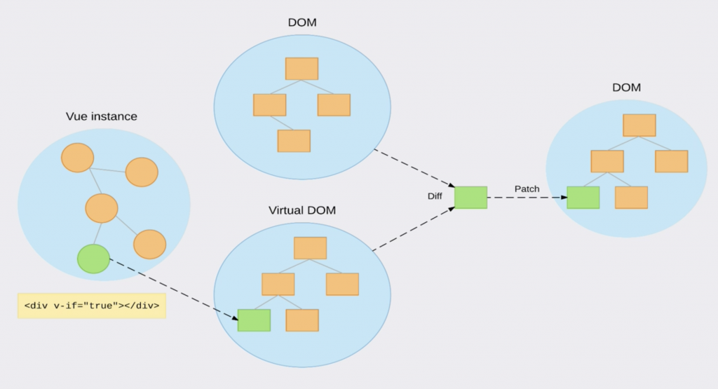
1. Virtual DOM
A representation of a DOM object, like a lightweight copy or a mockup object
Virtual DOM manipulation is much faster
Nothing gets drawn onscreen
Process multiple actions but patch one diff to the real DOM

Slide 7
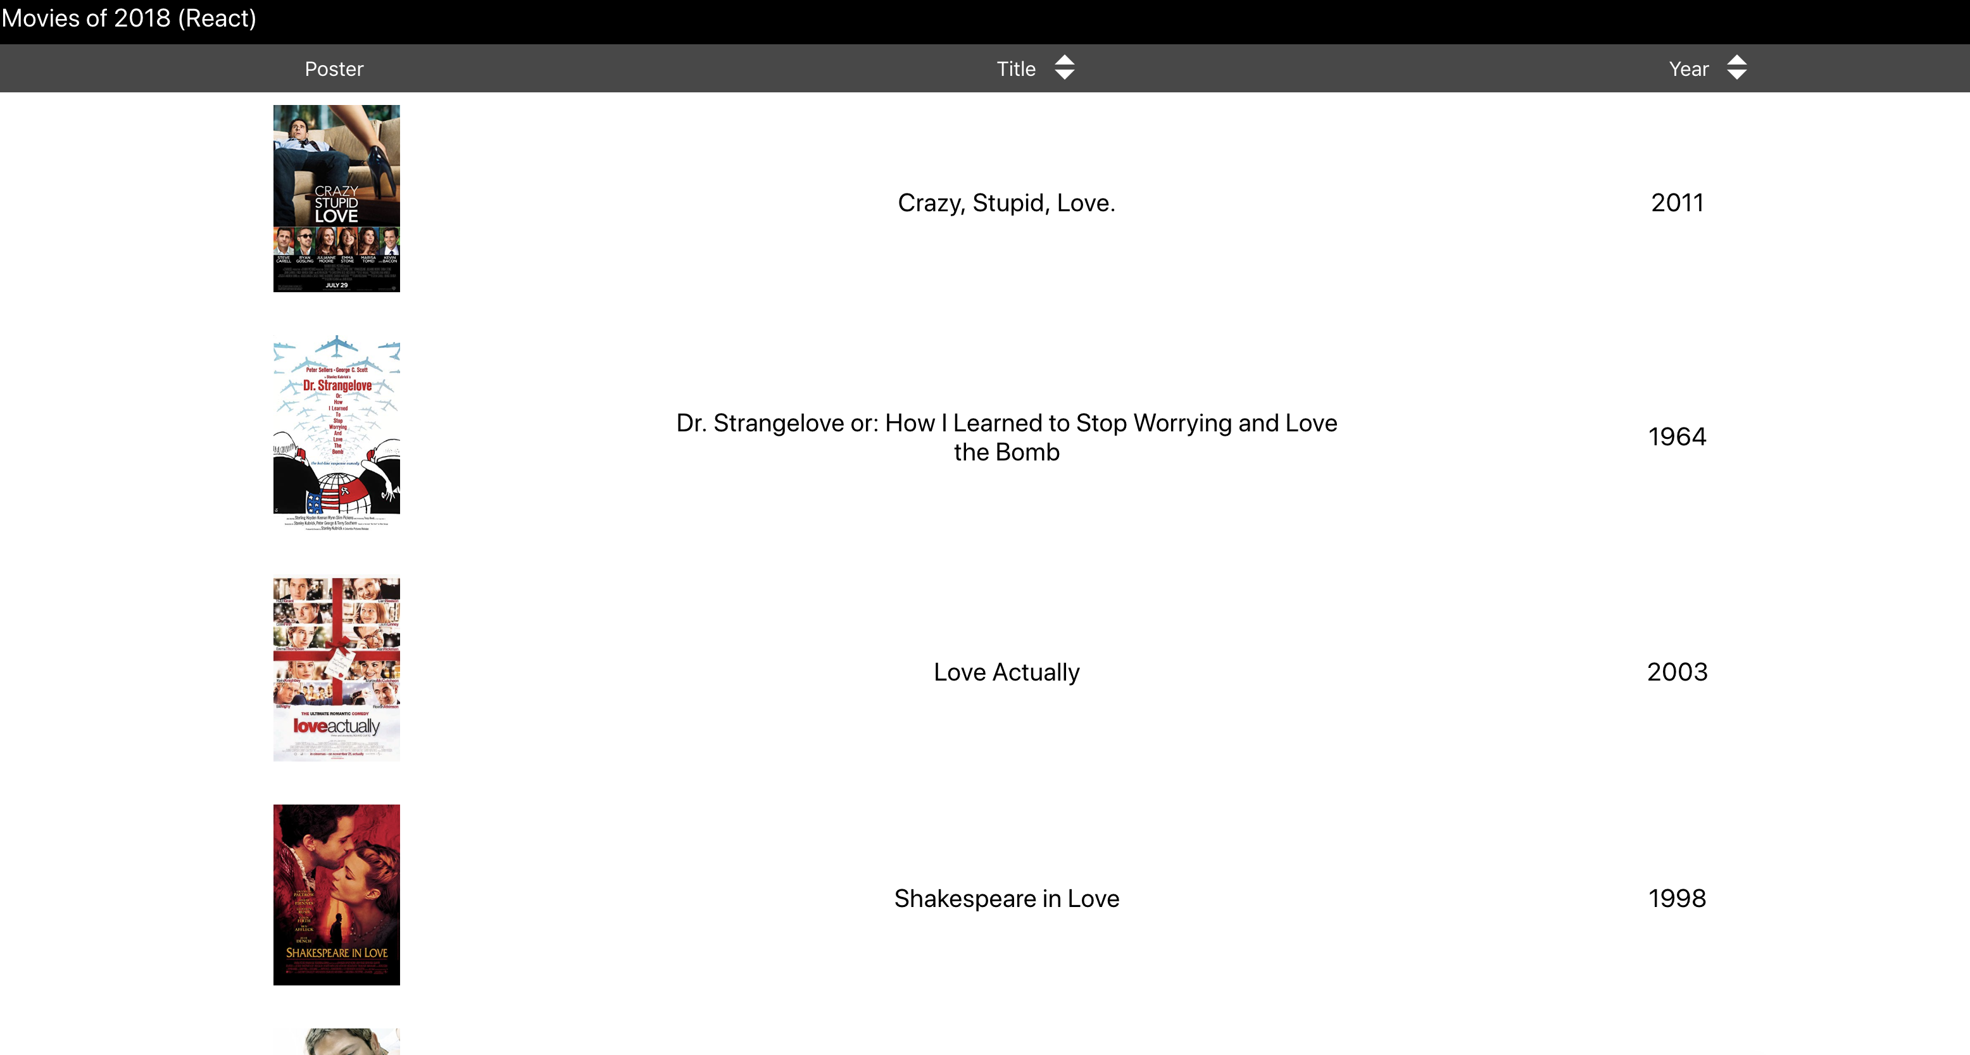

Comparison on Virtual DOM
Virtual DOM | Regular DOM
React, Vue | Angular, Backbone(jQuery)

Slide 8
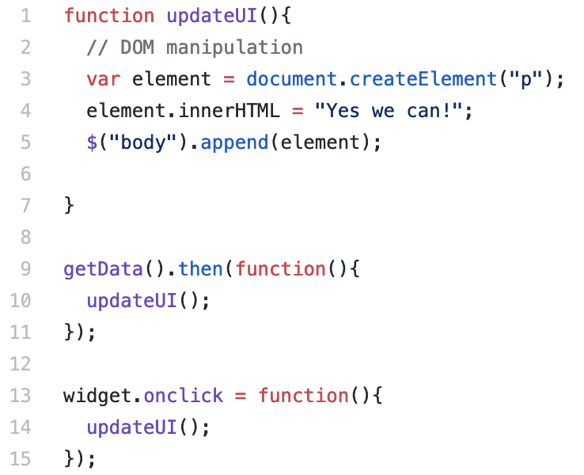
2. Data-binding
Let’s review how we develop the web frontend in the past.
Stone Age
Manually access the DOM
Embedded everything in the HTML
Both static data and dynamic state
MVC
Separate the data model from the mess
Helps us produce clean code
We still need to decide how and when to change the UI.
DOM Manipulation
How to.
Event handling
When to.

Slide 9
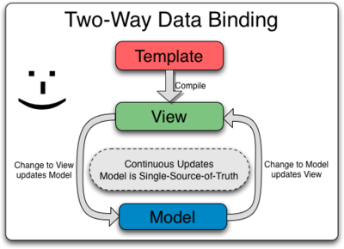
Data-binding for the win
Two-way data binding
The template compilation produces a live view
Any changes to the view are immediately reflected in the model
Any changes in the model are propagated to the view
Basically erase the code from project
About how to and when to update the UI
Instead
Need to declare the relations between runtime variables and HTML before template compilation

Slide 10
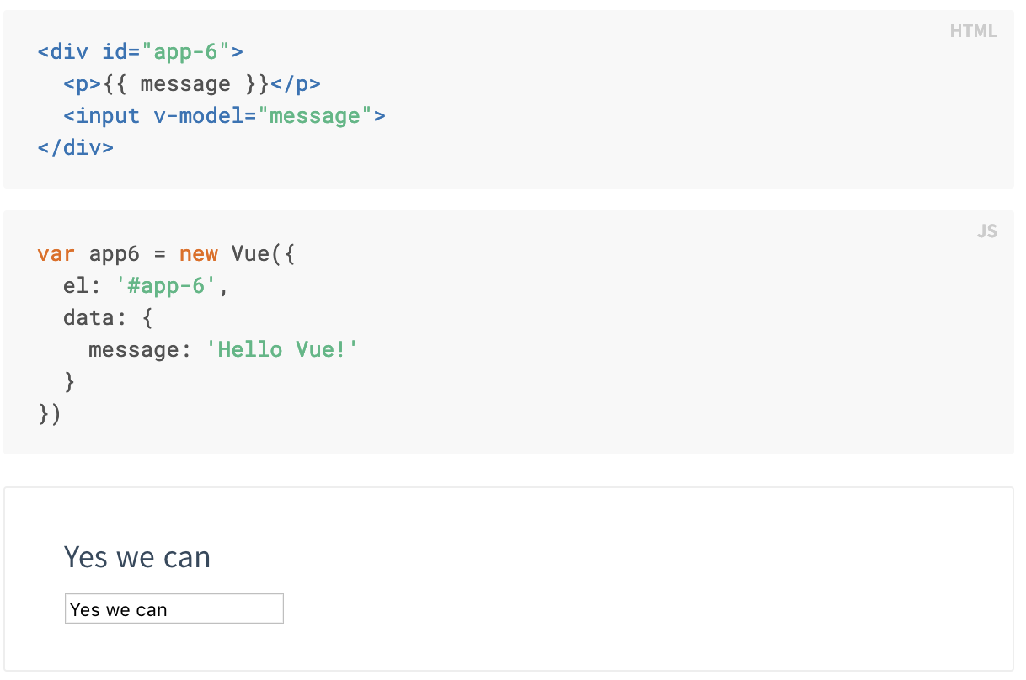
Example of Two-way Data-binding
Model to View
2. Bind ”message” to <p>
View to Model
3. Bind <input> to ”message”
1. Runtime variable in the “app-6”

Slide 11
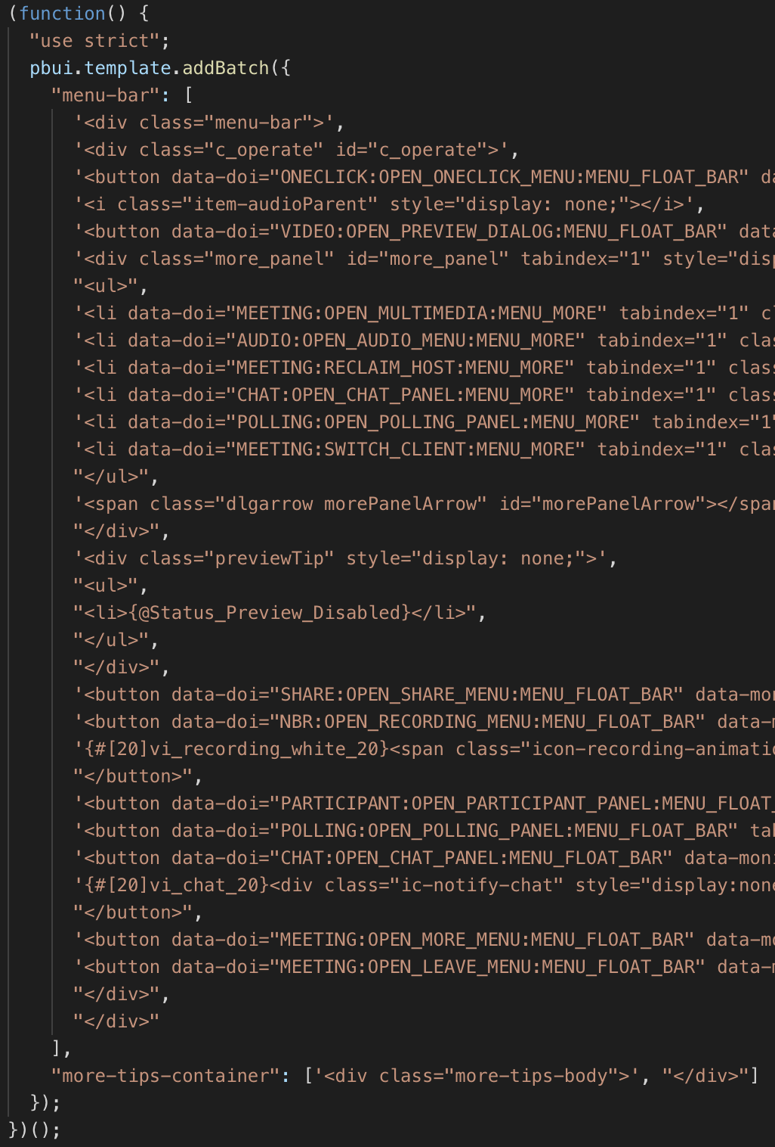
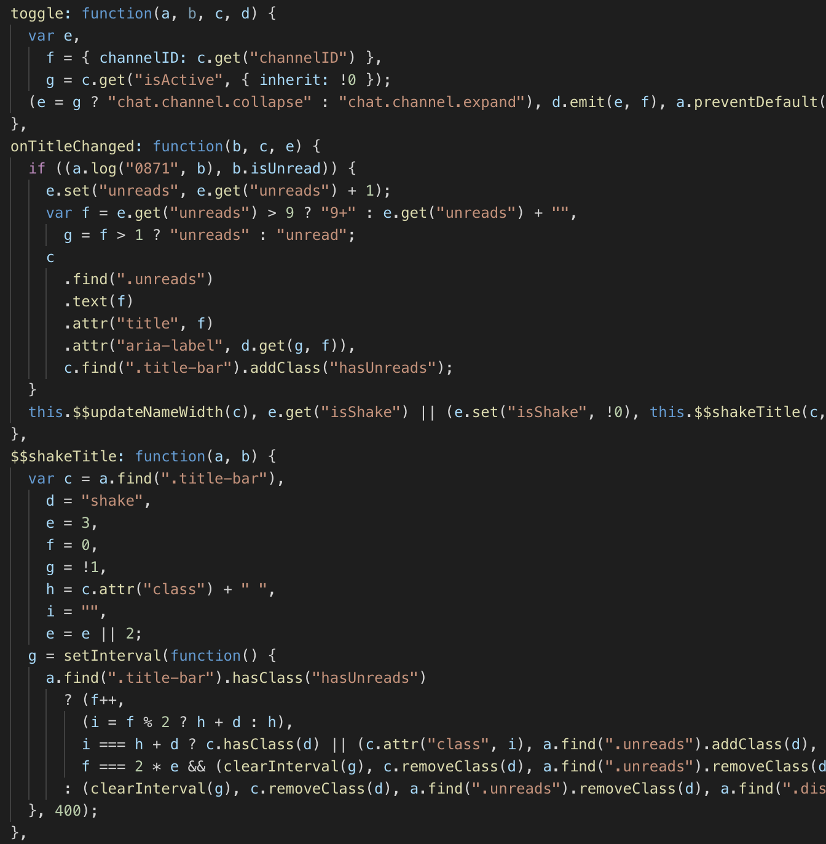
Example of Backbone+jQuery
Notes:
Without data-binding, we have to do the code in the right-hand side

Slide 12
Comparison on Advanced Data-binding
Advanced data-binding | Traditional workflow
Angular, React, Vue | Backbone(jQuery)

Slide 13
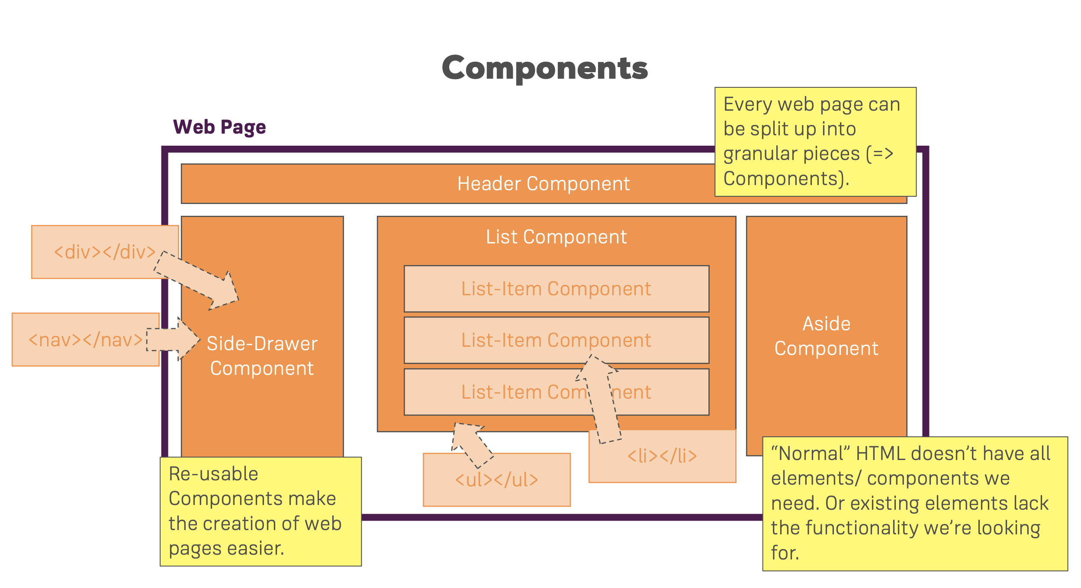
3. Code Reuse
MVC is a high level architecture. It did not specify how to design the “view”
Need jQuery to do the view in legacy thin client
The rendering is still a huge mess
Advanced data-binding helps, but not enough
UI Components
Components are the most basic UI building block. It’s all about the View
Logical component in the source code has to match the visual component

Slide 14
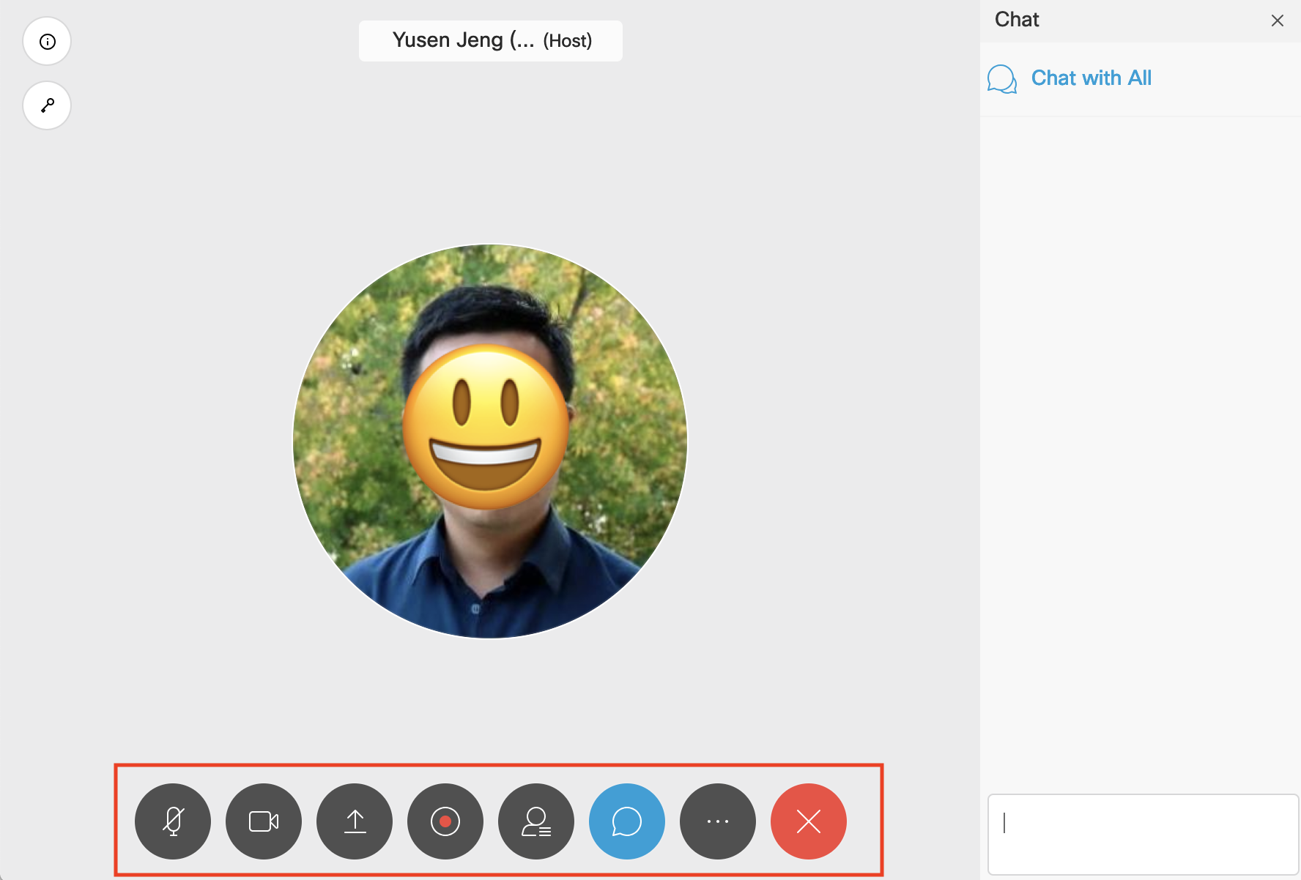
Example of not reusable code

Slide 15
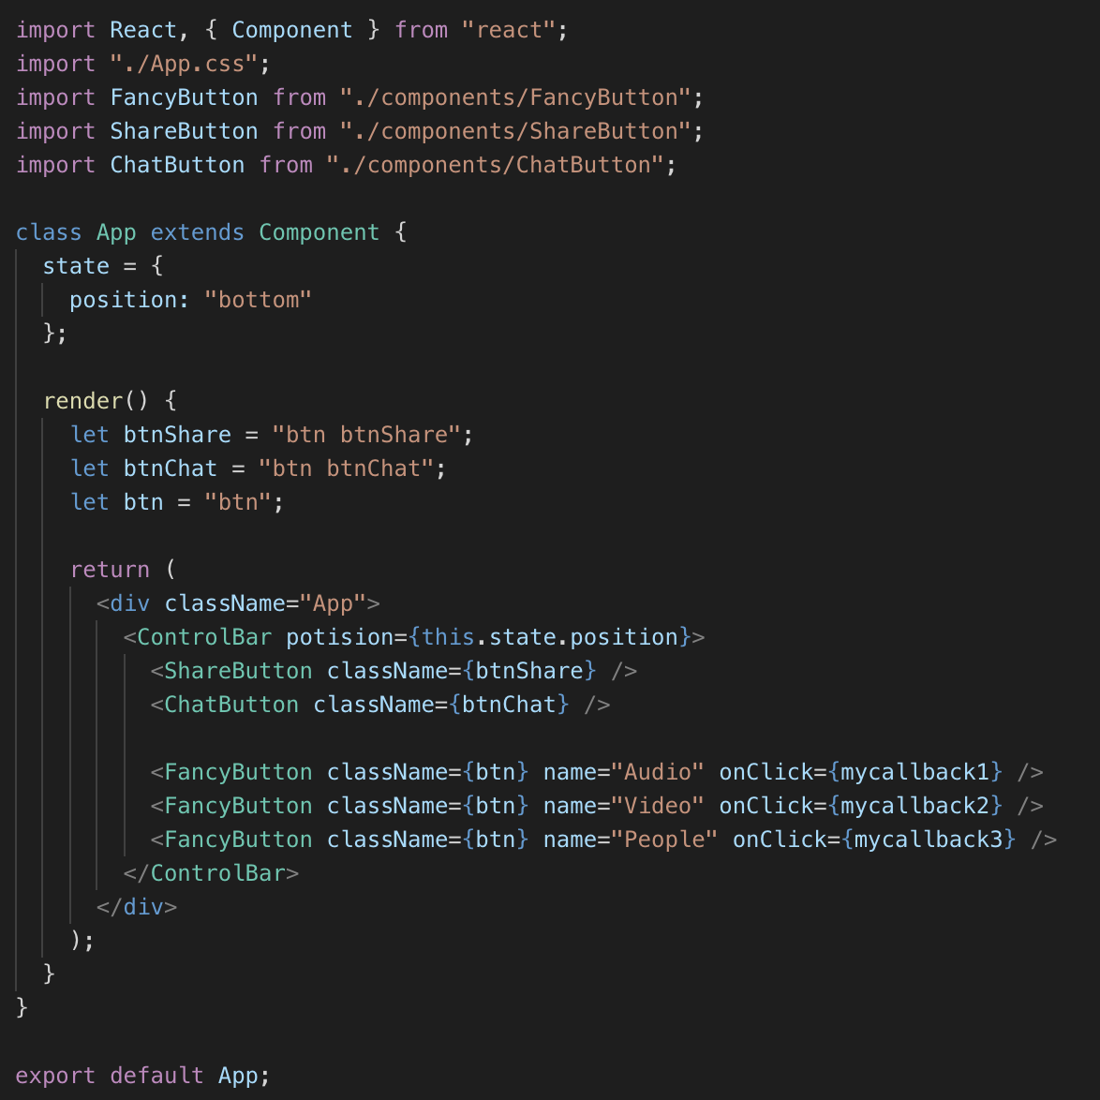
Example of reusable code

Slide 16
Comparison on Components Based View
UI Components | None
Angular, React, Vue | Backbone(jQuery)

Slide 17
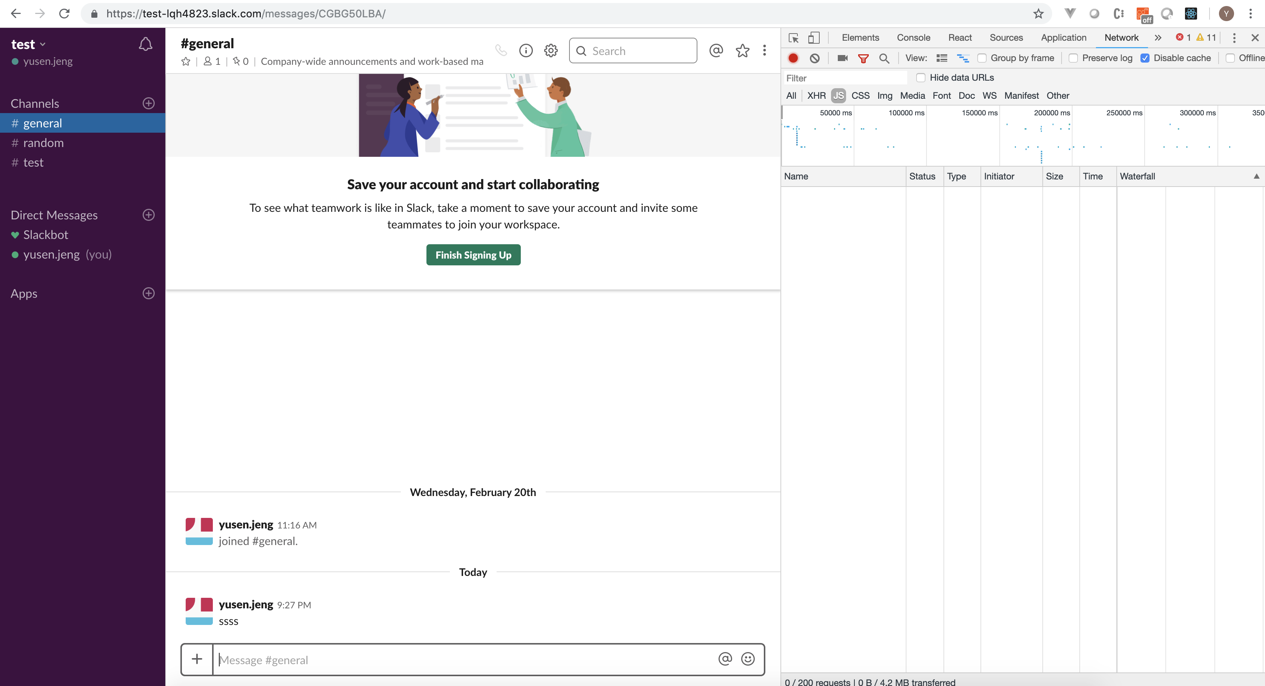
4. SPA : Client/Server Separation
In a single-page application, the routing system needs to be set up to navigate from one view to another.

Slide 18
Examples on Routing
Angular
React
Vue

Slide 19
All in all
 | Backbone-jq | Angular | React | Vue
Virtual DOM |  |  | O | O
Data-Binding |  | O | O | O
Code Reuse | X | O | O | O
Routing | Ugly | Elegant | Elegant | Elegant
Design | MVC | Component | Component | Component

Slide 20
Battles between Angular and React
Design philosophy
Angular is HTML centric
Using the special binding expressions in HTML attributes
Use TypeScript
High learning curve
React is JS centric
Makes React simple and focused
Very good for JS debugging
Vue is kind of mixed
Easy to learn

Slide 21
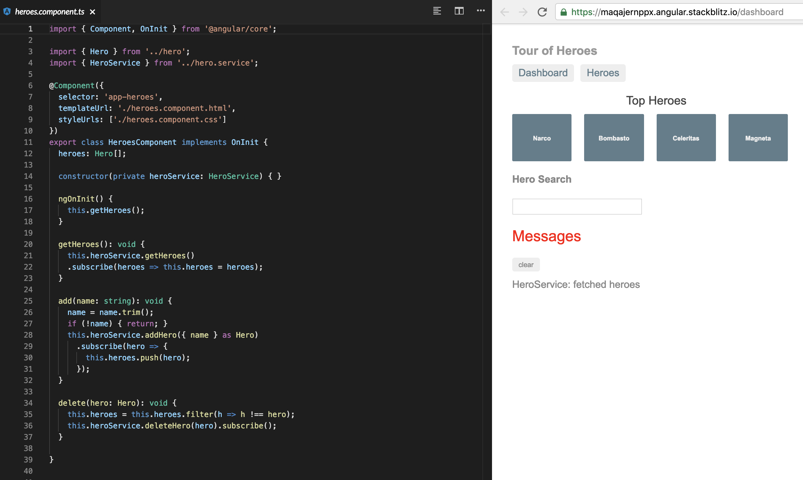
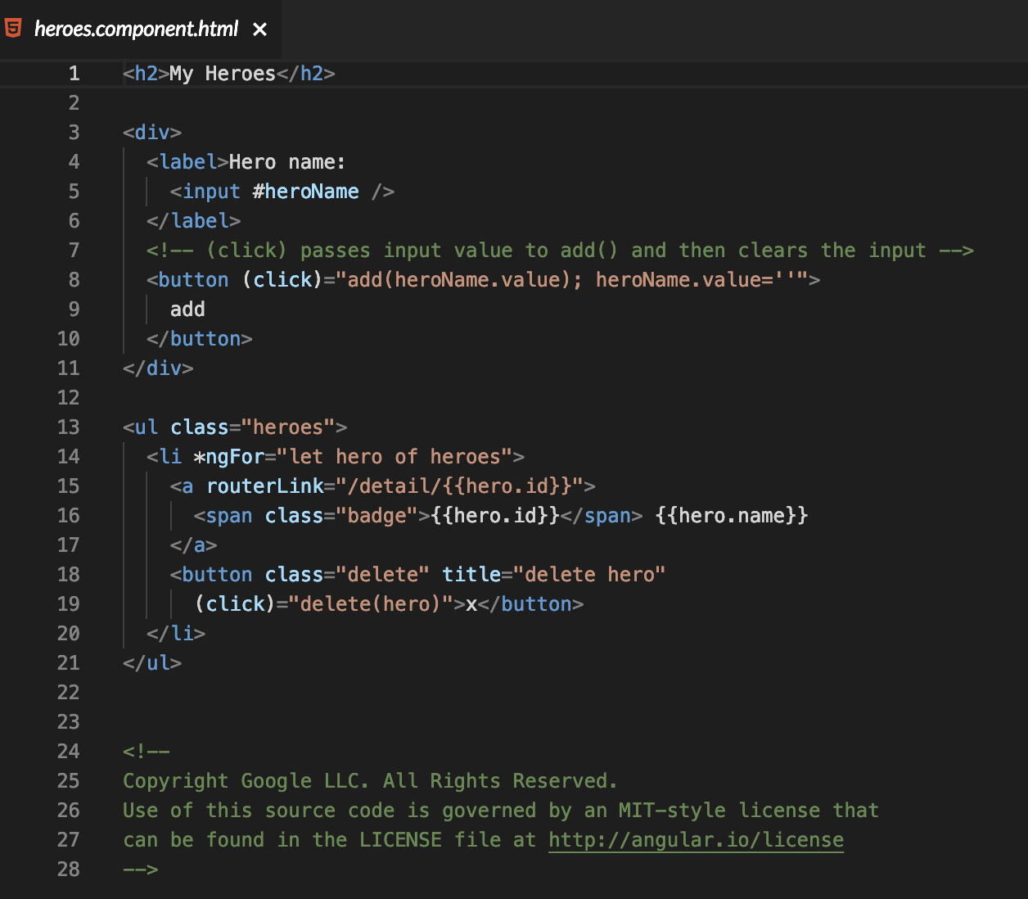
Angular Example

Slide 22
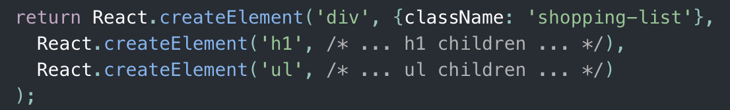
React Example

Slide 23
Battles between Angular and React
Design philosophy
Angular is HTML centric
Using the special binding expressions in HTML attributes
Use TypeScript
High learning curve
React is JS centric
Makes React simple and focused
Very good for JS debugging
Vue is kind of mixed
Easy to learn
Vue 3.0 will be written in TypeScript and released in 2019/2020

Slide 24
All in all (2nd round)
 | Angular | React | Vue
Authors | Google Communities | FB Communities | 尤雨溪（Evan You）
Language | TypeScript | JS | JS=>TypeScript
Virtual DOM | No | Yes | Yes
Style | HTML Centric | JS Centric | Mixed
Learning Curve | High | Mid | Low
Data-Binding | Yes | Yes | Yes
Documentation | Rich | Weak | Rich
Companies Using | Upwork, Freelancer, Udemy, YouTube, Paypal, Nike, Google, Telegram, Weather, iStockphoto, AWS, Crunchbase | Facebook, Instagram, Netflix, New York Times, Yahoo, Khan Academy, Whatsapp, Codecademy, Dropbox, Airbnb, Asana, Atlassian, Intercom, Microsoft | Xiaomi, Alibaba, WizzAir, EuroNews, Grammarly, Gitlab and Laracasts, Adobe, Behance, Codeship, Reuters
Size | ~500KB | ~100KB | ~80KB

Slide 25
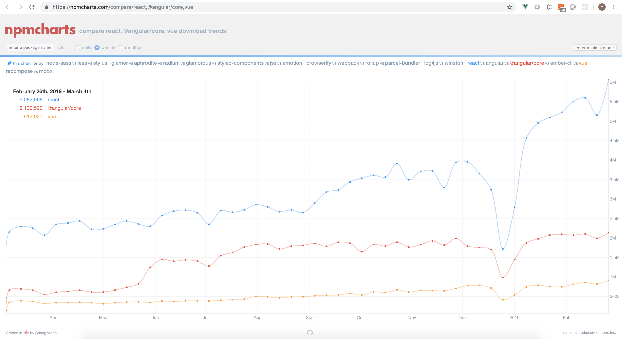
Download Trend @ npm

Slide 26
Summary
Recommend to use React as sdk’s GUI tool.
Also provide jQuery based samples as backup choice

